Slide 1
GraphQL - Introduction
SoftUni Team
Technical Trainers
Software University
http://softuni.bg

Slide 2
Table of Contents
Traditional REST
What is GraphQL ?
Concepts in GraphQL

Slide 3



Learn to Search in Internet
The course assignments require to search in Internet
This is an important part of the learning process
Some exercises intentionally have no hints
Learn to find solutions!
Software development includes everyday searching and learning
No excuses, just learn to study!
Developers learn new technologies, tools, languages every day!

Slide 4
Traditional REST

Slide 5
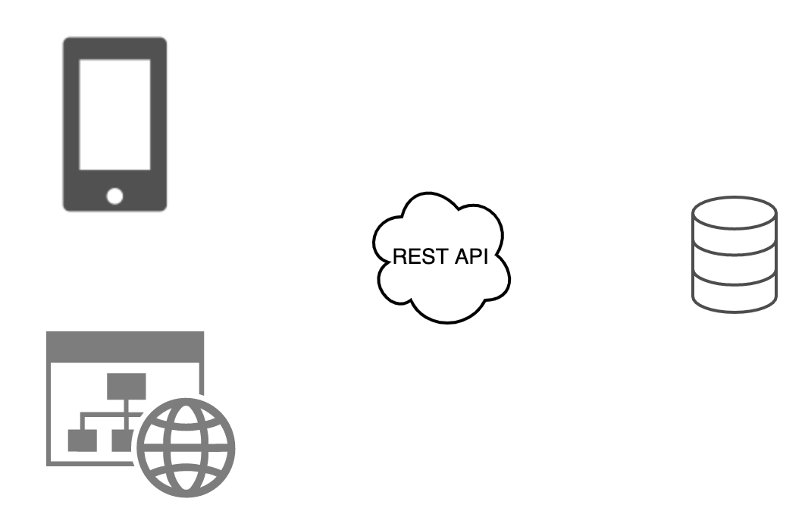
REST system
GET https://backend-url.com/users
GET https://backend-url.com/users/1
GET https://backend-url.com/users/1/posts
PUT https://backend-url.com/users/1/posts/4

Slide 6
Representational state transfer (REST)
Invented by Roy Fielding in 2000
Architecture style that defines a set of constraints to be used for creating Web services
Web services that conform this style are called RESTfull services

Slide 7
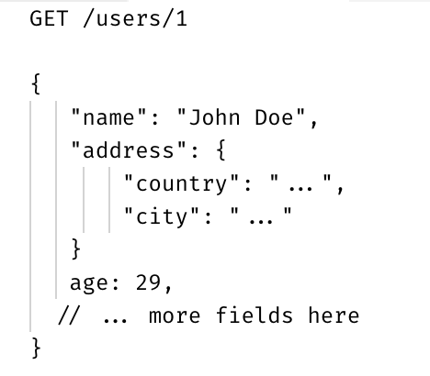
Resources
The core idea of REST is resources

Slide 8
REST principles
Uniform interface - we always use the HTTP verbs (GET, POST, DELETE, etc.), URLs and always get response with status and body
Stateless - each request is self-descriptive
Client-server - client should be separated from the server, so each of them can be developed individually
Cacheable - caching shall be applied to resources applicably and those resources should be explicitly marked as cacheable

Slide 9
What is GraphQL ?

Slide 10
GraphQL
New API standard that enables declarative data fetching
Developed internally at Facebook in 2012 and open-sourced in 2015
Exposes a single endpoint (as opposed to REST) and responds only with the data requested from the client
Aims to provide more powerful and flexible alternative to REST

Slide 11
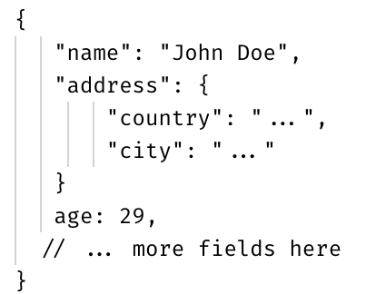
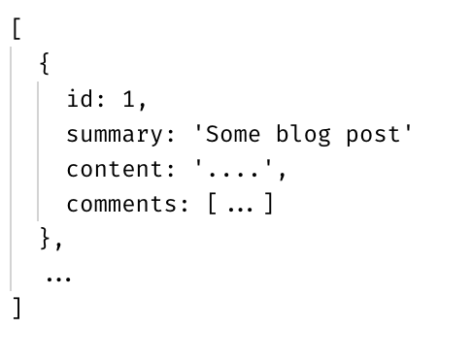
Blog example (REST)
John Doe
Posts:
1) Intro to GraphQL
2) GraphQL is so cool
3) Other fancy blog post
...
Last 3 followers:
Jane Doe, Richard Roe, John Wick
GET /users/1/
GET /users/1/posts
GET /users/1/followers

Slide 12
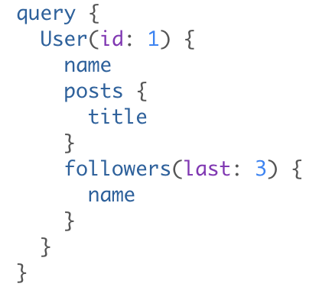
Blog example (GraphQL)
John Doe
Posts:
1) Intro to GraphQL
2) GraphQL is so cool
3) Other fancy blog post
...
Last 3 followers:
Jane Doe, Richard Roe, John Wick
POST /graphql

Slide 13
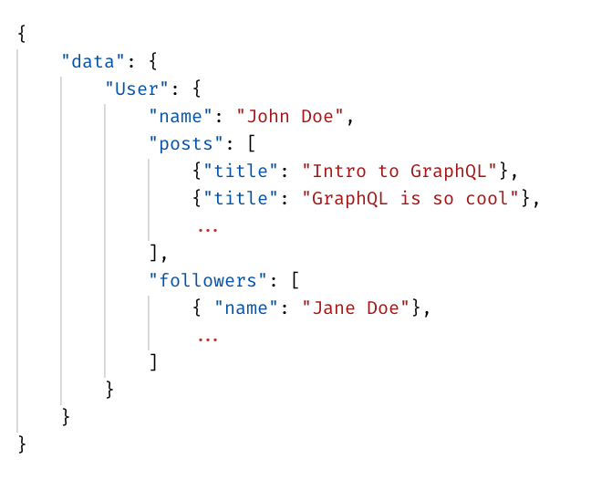
Blog example (GraphQL)
Response from GraphQL

Slide 14
GraphQL Advantages
Provides declarative data retrieval instead of imperative
Removes Overfetching and Undefetching (n+1 problem)
Improves versioning
More rapid development
We can get as much data as we want with a single request to the database

Slide 15
Concepts in GraphQL

Slide 16
Concepts in GraphQL
The Schema Definition Language (SDL)
Type system
Queries
Mutations
Client & server
Subscriptions

Slide 17
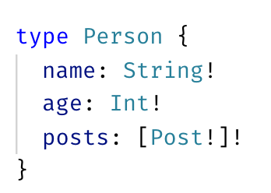
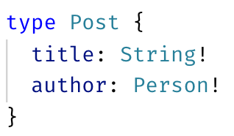
Schema definition language (SDL)
GraphQL has own type system that is used to define the schema of the API
The syntax for writing schemas is called SDL

Slide 18
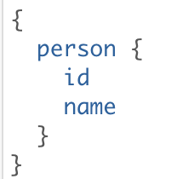
Type system
GraphQL language is basically about selecting fields on objects
The query starts from the special “root” object
From that object, select the person field
For the object returned for the person field, select id and name

Slide 19
Type system
Every GraphQL server defines a schema which describe the set of possible data that can be queried
The schema answers the following questions:
What types can be queried? (e.g Person and Post)
What fields / sub-fields can be selected ?
What is the actual type of a field? (e.g String or Int )

Slide 20
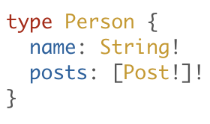
Object types
The basic components of GraphQL schema are Object types
It’s just an object with fields
Person is GraphQL Object Type
String! means that the name field is of type string and is non-nullable
[Posts!]! means that the posts field is an array of non-nullable Post objects and that the array itself is non-nullable

Slide 21
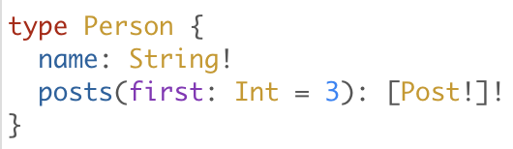
Field arguments
Every field can have zero or more arguments
The arguments can be optional and required
Passed by name (unlike function arguments in JS)

Slide 22
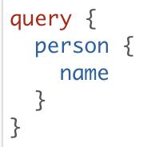
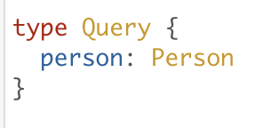
Query and Mutation object types
Special object types that act like the entry point of the API
Query is mandatory for every schema, Mutation is optional

Slide 23
Scalar types
Scalar types are the leaves of the query (they don’t have sub-fields)
Int - A signed 32‐bit integer.
Float - A signed double-precision floating-point value.
String - A UTF‐8 character sequence.
Boolean - true or false.
ID - unique identifier used for caching

Slide 24
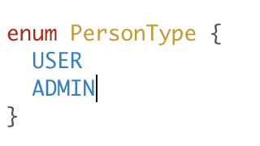
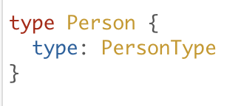
Enumeration types
Special kind of scalar restricted to a particular set of values

Slide 25
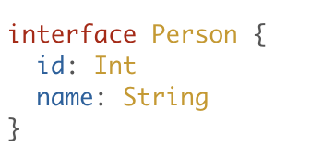
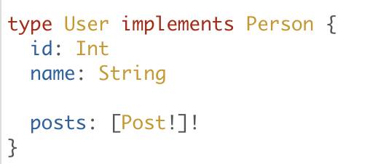
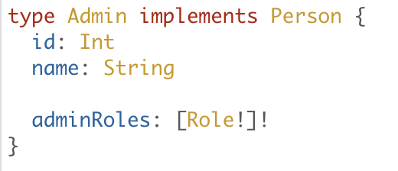
Interfaces
Interfaces are abstract types that define set of fields

Slide 26
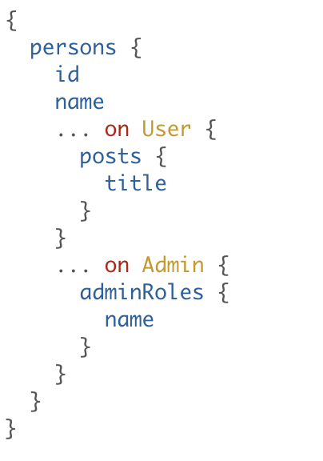
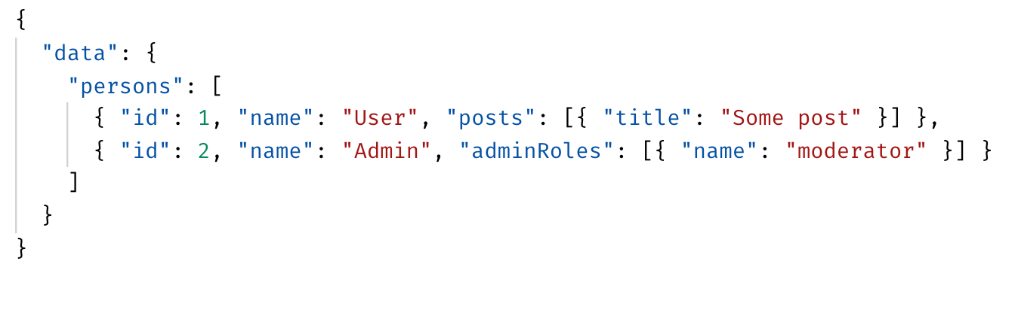
Interfaces

Slide 27
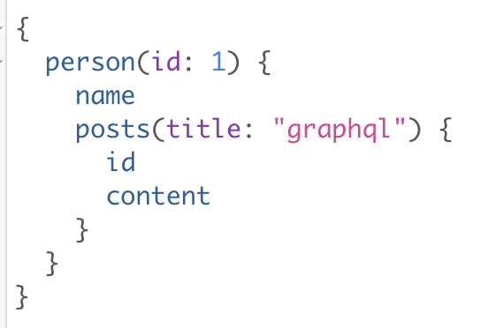
Query arguments
In GraphQL query, every field can get it’s own set of arguments

Slide 28
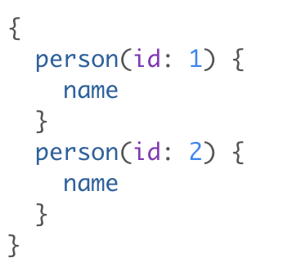
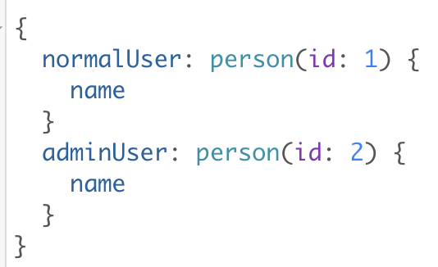
Field aliases
It’s possible to request the same field multiple times in a single query

Slide 29
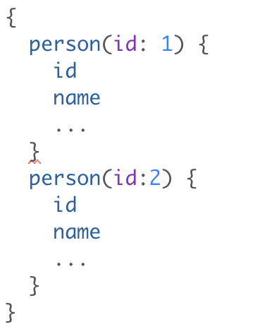
Fragments
Allows us to reuse parts of the query

Slide 30
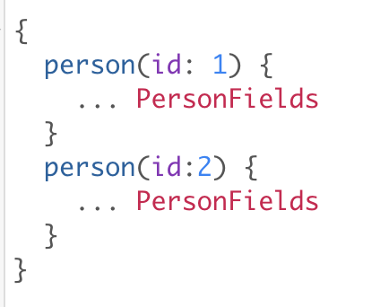
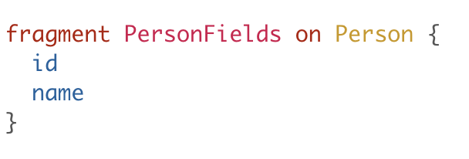
Fragments

Slide 31
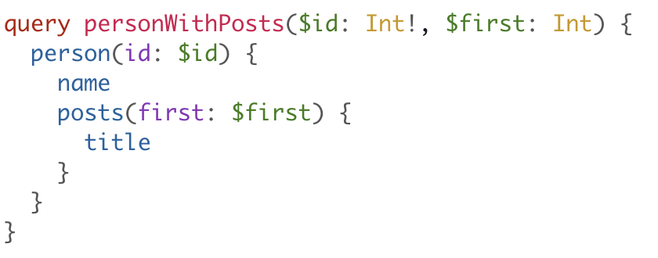
Variables
Provides a way to remove the hard-coded query arguments
The variables dictionary is passed in the body of the HTTP request

Slide 32
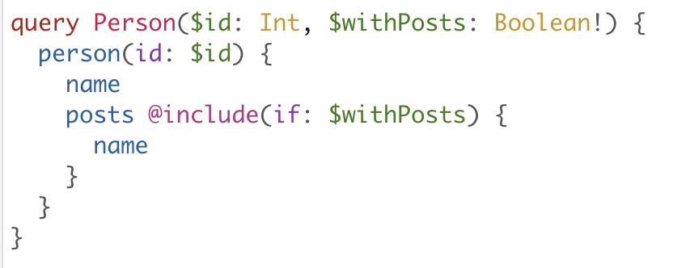
Directives
Used to dynamically change the shape and structure of queries

Slide 33
Directives
A directive can be attached to any field or fragment inclusion
Can affect the execution of the query in any way the server desires
The GraphQL Spec includes two directives:
@include(if: Boolean)
@skip(if: Boolean)
Server implementations may have some experimental directives

Slide 34
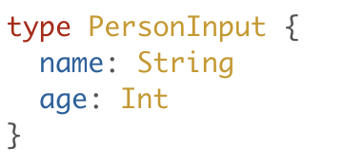
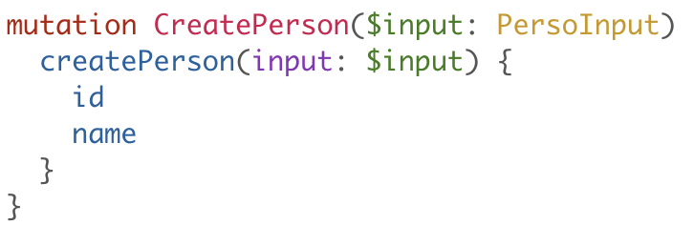
Mutations
By convention Queries only fetch data and don’t cause side effects
For side effects and data changes use Mutations

Slide 35
__typename field
In some cases we need to know the return type of a field
Include the __typename field at any point of the query to get the return type of that field

Slide 36
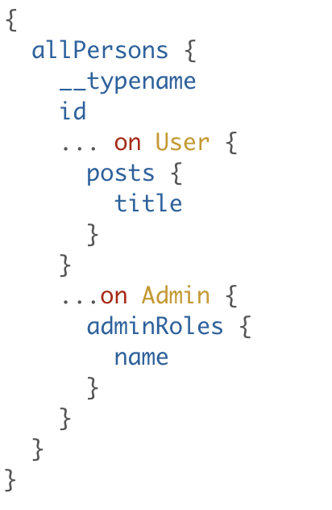
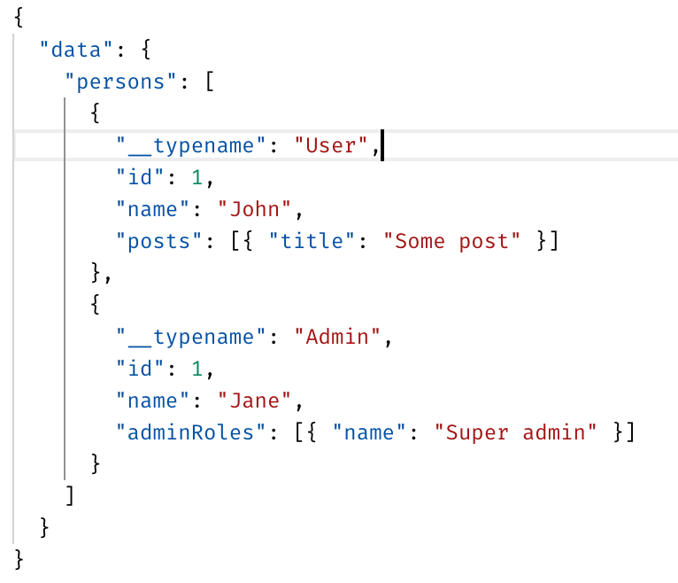
__typename field

Slide 37
Introspection system
GraphQL provides a few fields which can be used to obtain information regarding the schema on the server
__schema field - returns information about the types used in the schema
_type(name: “SomeTypeName”) - returns information about a specific type

Slide 38
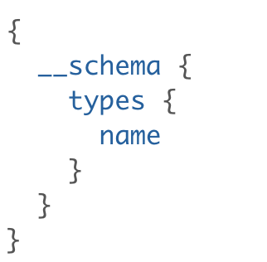
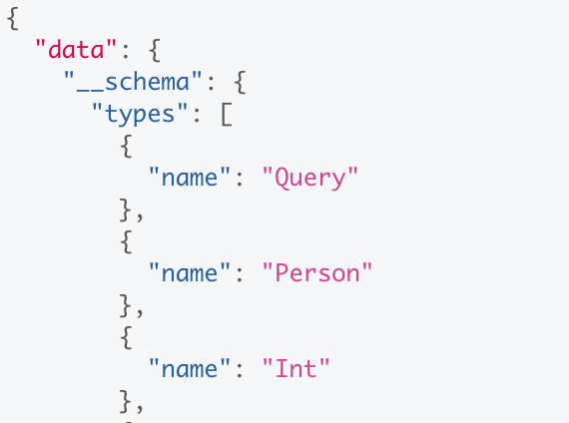
__schema field

Slide 39
DEMOS
Notes:
Show implementation of the flux pattern

Slide 41






СофтУни диамантени партньори

Slide 42






СофтУни диамантени партньори

Slide 43





Trainings @ Software University (SoftUni)
Software University – High-Quality Education, Profession and Job for Software Developers
softuni.bg
Software University Foundation
http://softuni.foundation/
Software University @ Facebook
facebook.com/SoftwareUniversity
Software University Forums
forum.softuni.bg

